Slide 1

CLup presentation

Slide 2
Requirement Analysis and Specification Document

Slide 3
MOST IMPORTANT GOALS
In broad terms our future clients would require:
Allowing customers to go to stores as per usual
Providing safety to customers
Permit store managers to check the number of people inside the store

Slide 4
DOMAIN ASSUMPTIONS
What the system-to-be would not control was that:
Users would take the shortest path to shops
Where users would spend most of their time in and out of the store
Users would follow social distancing rules
The data regarding stores would be truthful
Majority of clients would not wait in front of the store for no reason

Slide 5
FUNCTIONAL REQUIREMENTS
In broad terms the system should:
Allow users to book visits and get tickets.
Only allow users who have an appointment to enter stores.
Allow store managers to see statistics and manage the number of entrances allowed.
Notify users of upcoming appointments or availabilities of timeslots that they are interested in

Slide 6
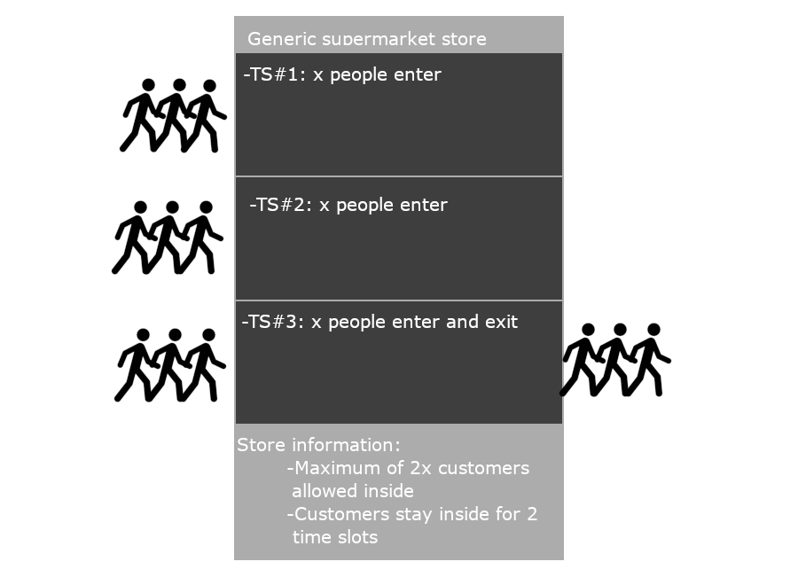
BUT WHAT ARE TIMESLOTS?
Time slots are slots of time, generally 15 minutes.
Why timeslots?
To provide safety in front of the stores
To let clients go in without the need of a queue
To consider a percentage of human error (delay)

Slide 7
USE CASES
Book Visit
Actor | Virtual User
Entry condition | The user is already logged in or wants to access as a guest
Events flow | The user selects the “Book visit” button The user either selects a timeslot (then a store) or a store he would want to go (then a timeslot) The user optionally inserts information about the expected duration of the shop trip and the items (or categories) he intends to purchase The system provides the virtual ticket containing: timeslot, store’s name and address, QR code to enter the store
Exit condition | The user successfully receives the virtual ticket

Slide 8
USE CASES (CONT.)
Get Physical Ticket
Actor | Physical User
Entry condition | The user is in front of the ticket dispenser of the store
Events flow | The user clicks on the “Get Ticket” button The user visualizes the first available timeslot The user clicks on the “Confirm” button The ticket dispenser gives out the physical ticket containing: timeslot, store’s name and address, QR code to enter the store
Exit condition | The user successfully receives the physical ticket

Slide 9
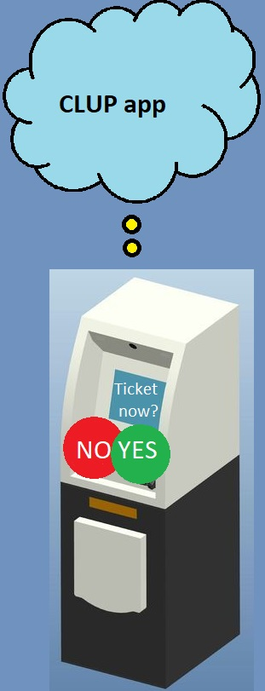
SYSTEM INTERFACES (with)
The system-to-be will interface with:
One (or many) memory storage unit(s)
External geo-location API and notification API
The internet
Physical ticket dispensers
Turnstiles and QR scanners
User devices

Slide 10
SYSTEM CONSTRAINTS
The system will have to:
Comply with local laws regarding COVID-19 and its safety related regulations.
Comply with local laws about data treatment and usage such as the EU General Data Protection Regulation GDPR 2016/679.
Be “light” in computation terms, to support old devices.
Be reliable, supporting a 10% increase of workload w.r.t. the worst-case scenario (defined in RASD)

Slide 11
Design Document

Slide 12
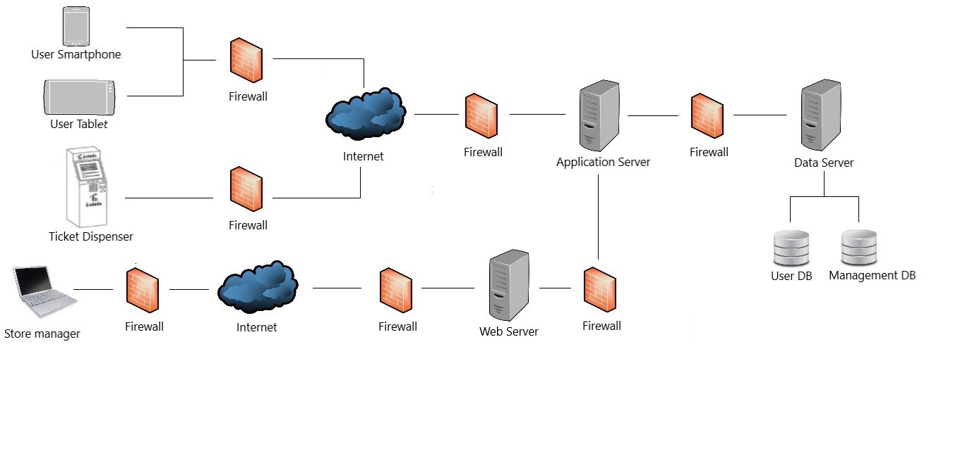
GENERAL ARCHITECTURE
Figure 2.1 – high level architecture

Slide 13
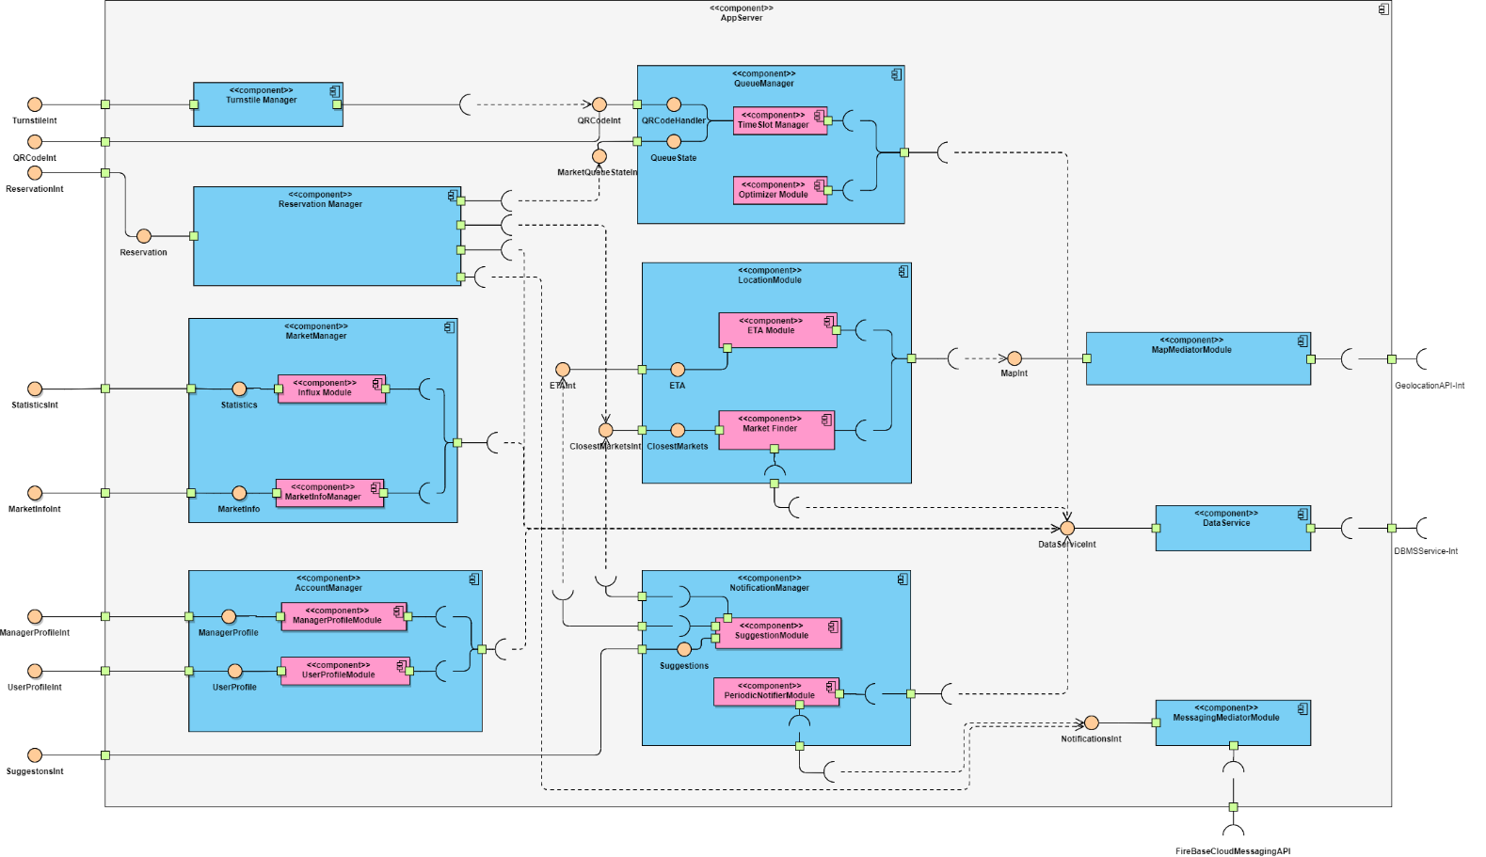
APPSERVER ARCHITECTURE

Slide 14
APPSERVER ARCHITECTURE (cont.)
To provide the most cohesion between components of the App-server we have used the following architectural styles and techniques:
Notification push pattern through Firebase Cloud Messaging (Google API)
Mediator Pattern, for the modules that deal with external APIs such as Google Maps’ API and Firebase API

Slide 15
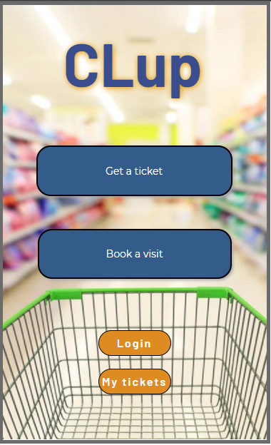
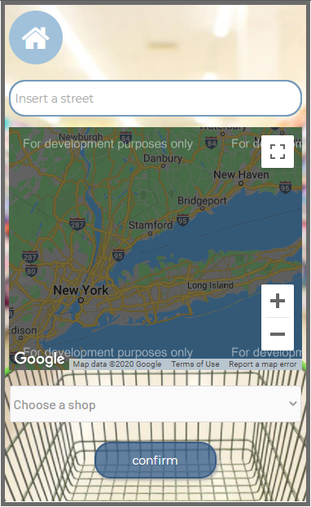
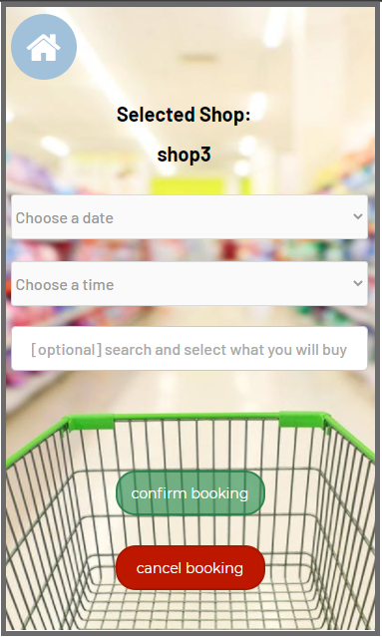
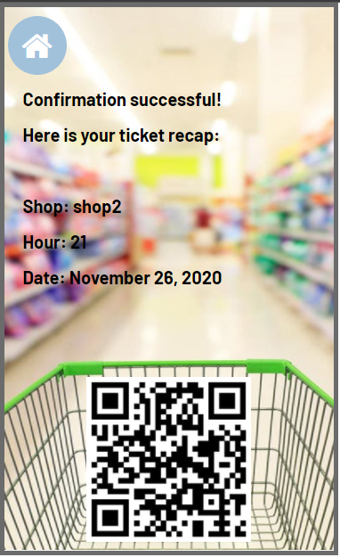
USER INTERFACE DESIGN
Mobile App

Slide 16
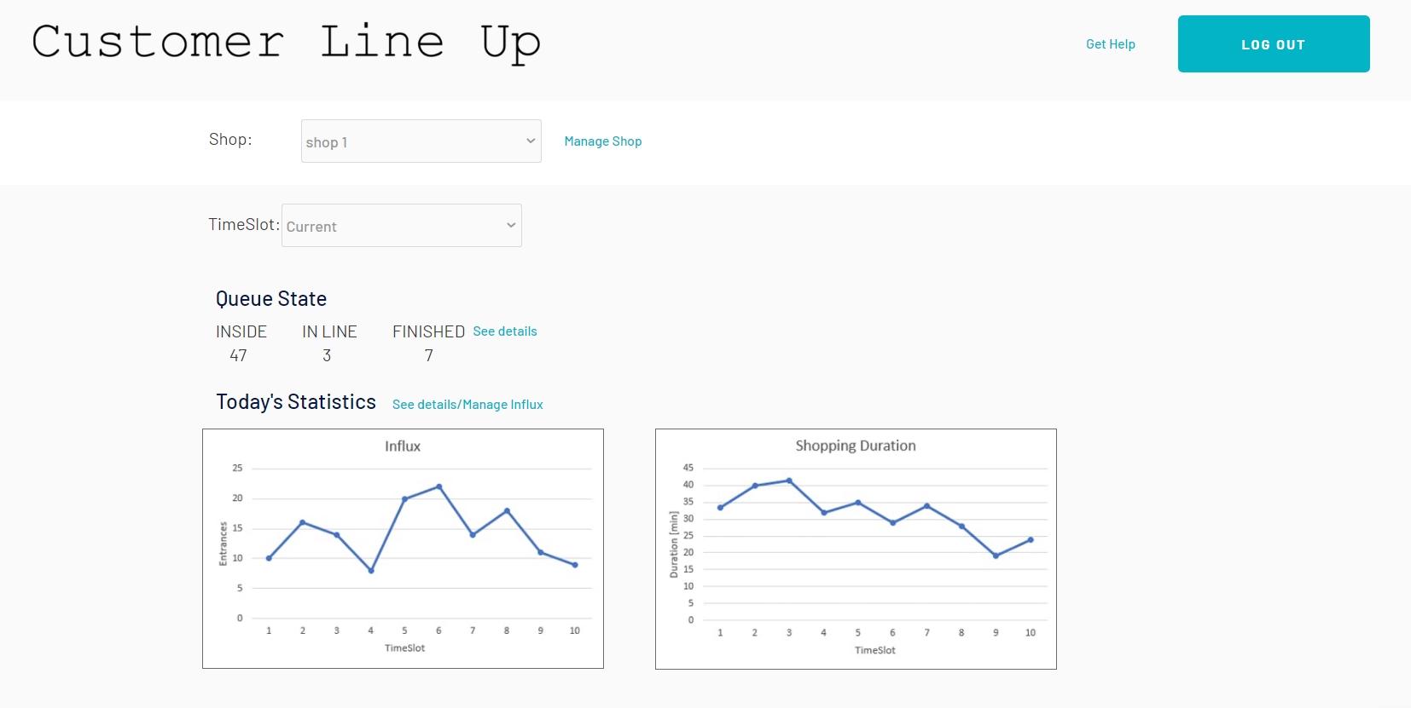
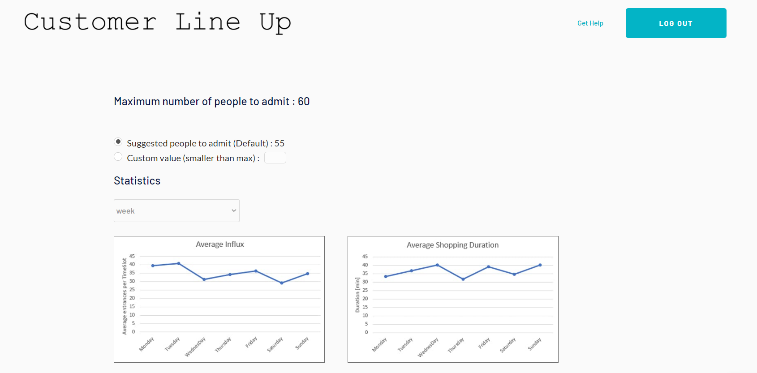
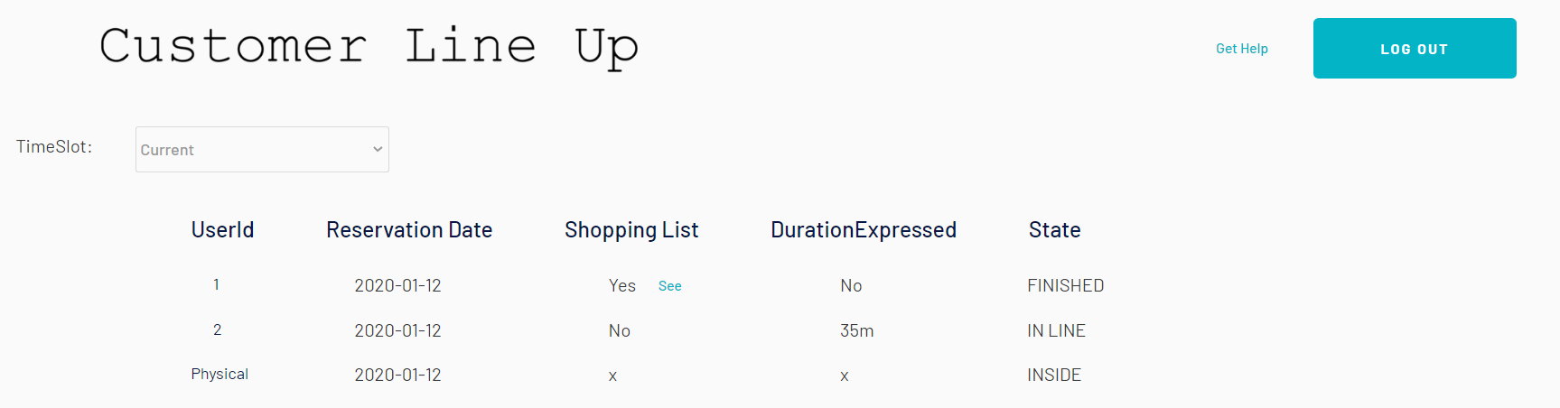
USER INTERFACE DESIGN
Web App for Managers

Slide 17
IMPLEMENTATION, INTEGRATION AND TESTING
We plan to use the bottom-up strategy because:
The errors in the low-level modules are identified early in the process.
The meaningful effective integration of the upper-level modules can be done.
No time is wasted waiting for all modules to be developed

Slide 18
IMPLEMENTATION, INTEGRATION AND TESTING (cont.)
According to the bottom-up approach we have divided the components in three groups:
Data Service, Map Mediator Module, Messaging Mediator Module
Location Module, Queue Manager, Account Manager, Market Manager
Reservation Manager, Notification Manager, Turnstile Manager
After having implemented all components we follow up with the implementation of the Web app and the Client app,
Note: the DBMS service, the Geolocation API and the Firebase Cloud Messaging API are assumed to work properly since are external services.

Slide 19
Questions?

